Slide 1

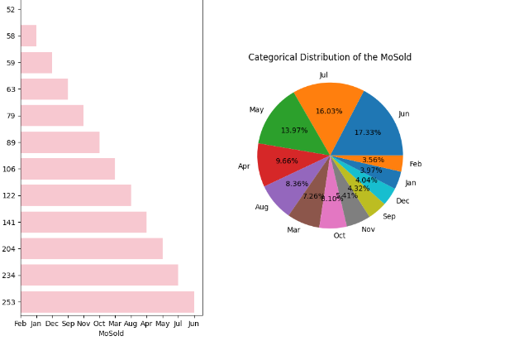
Exploratory Data Analysis (EDA) for Real Estate Pricing
ASHA SANDEEP
NOIDA
DIGICHROME ACADEMY

Slide 2
Introduction
Exploratory Data Analysis (EDA) involves examining and understanding the structure, patterns, and relationships within a dataset.Exploratory Data Analysis (EDA) involves several steps to gain insights into the dataset. Here are the typical steps along.
Load the Dataset
Understand the Dataset
Summary Statistics
Data Visualization:
Correlation Analysis:
Feature Engineering
Outlier Detection
Data Cleaning:

Slide 3
Project Overview
compelling visual representations, you are expected to discern hidden patterns and outliers that can significantly impact the pricing strategy.
The ultimate objective is to empower the real estate company with a deeper understanding of the market forces at play. Your insights will guide the pricing strategy, facilitating better decision-making for property acquisition, sales, and negotiation. Moreover, your findings may uncover opportunities for optimizing property values, enhancing customer satisfaction, and gaining a competitive edge in a dynamic and ever-evolving real estate landscape.

Slide 4
Project Overview
Timeline - 28th,April,2024.
Deadline -2nd june,2024.

Slide 5
Project Overview
The real estate industry is inherently complex, influenced by numerous factors that collectively impact the pricing of residential properties. The task at hand is to navigate through this complexity and extract meaningful insights from the available data. As an analytics professional, you are entrusted with the responsibility to not only identify the key variables affecting house prices but also to provide actionable recommendations based on your findings.
The dataset at your disposal comprises diverse parameters such as location, size, amenities, market trends, economic indicators, and historical transaction data. These variables contribute to the intricate web of pricing dynamics, and your role is to unravel their interdependencies through meticulous analysis.
Your analysis should go beyond simple correlation assessments, delving into advanced statistical methods and visualizations. By employing regression models, clustering techniques, and

Slide 6
Problem Statement
In the dynamic landscape of the residential real estate market, determining an optimal and competitive price for a house is a multifaceted challenge. As a key member of the analytics team in a leading real estate company, your task is to conduct a comprehensive analysis to identify and understand the myriad variables that significantly influence house prices. By leveraging advanced data analytics techniques and visualization tools, your goal is to uncover patterns, correlations, and trends within the dataset, enabling the company to make informed decisions and strategically position properties for better business opportunities.

Slide 7
Solution
I got the solution from the geeks for geeks articles and google.

Slide 8
Methodology
Methodology
Exploratory Analysis:
Used scatter plots to visualize the relationships between the number of bedrooms, bathrooms, square footage, and house prices.
Conducted correlation analysis to quantify the strength of these relationships.
Feature Engineering:
Created a new feature, price_per_sqft, to better capture the valuation per unit area.
Analyzed the distribution of the new feature and its impact on house prices.
Visualization:
Visualized the distribution of key features and their relationships with house prices using scatter plots and heatmaps.
Used histograms and density plots to understand the distribution of the newly engineered feature.

Slide 9
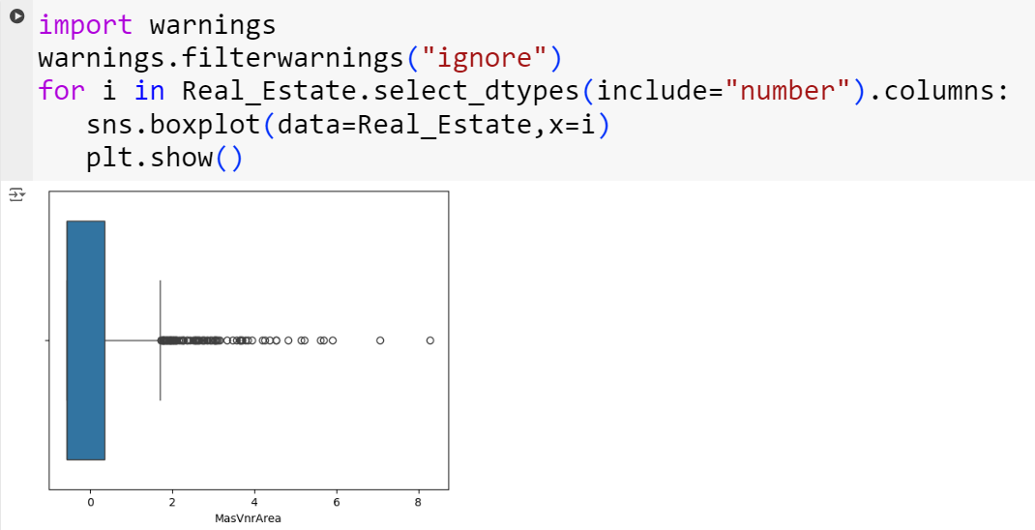
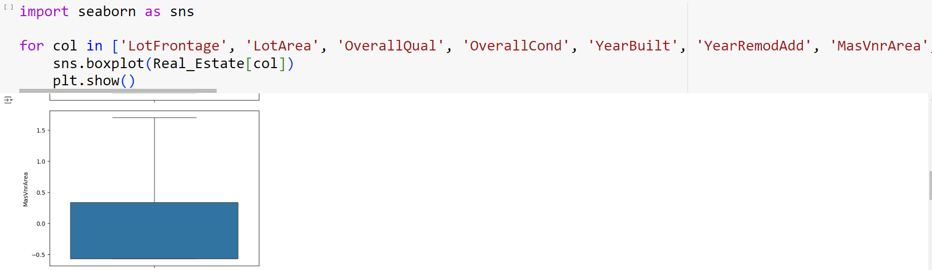
Key features
Key features of EDA
Data Understanding,Missing Values,Outlier Detection,Descriptive Data Transformation:Statistics,Data Visualization,Correlation Analysis,Feature Distribution,Data Transformation,Dimensionality Reduction,Feature Selection.

Slide 10
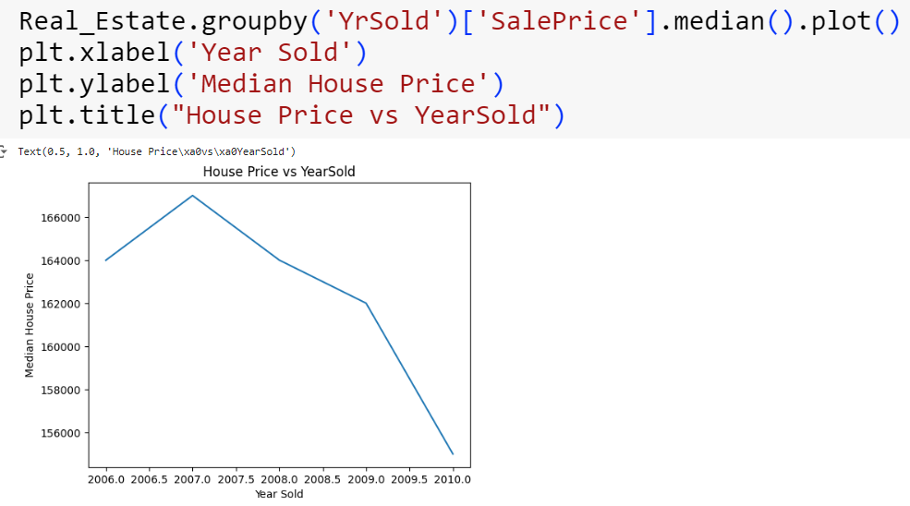
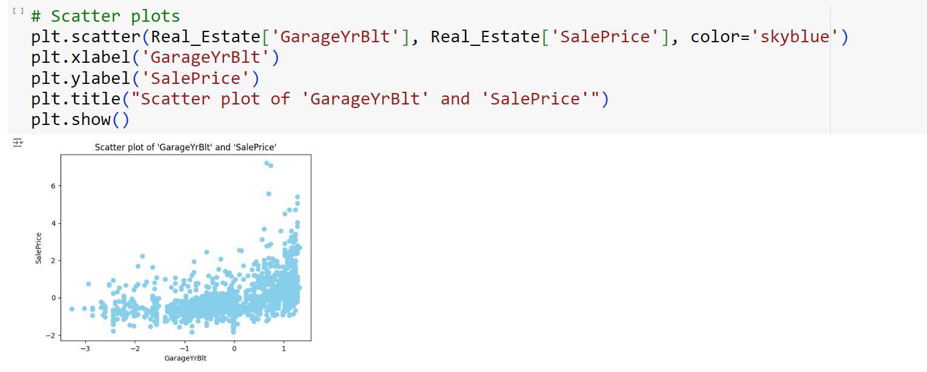
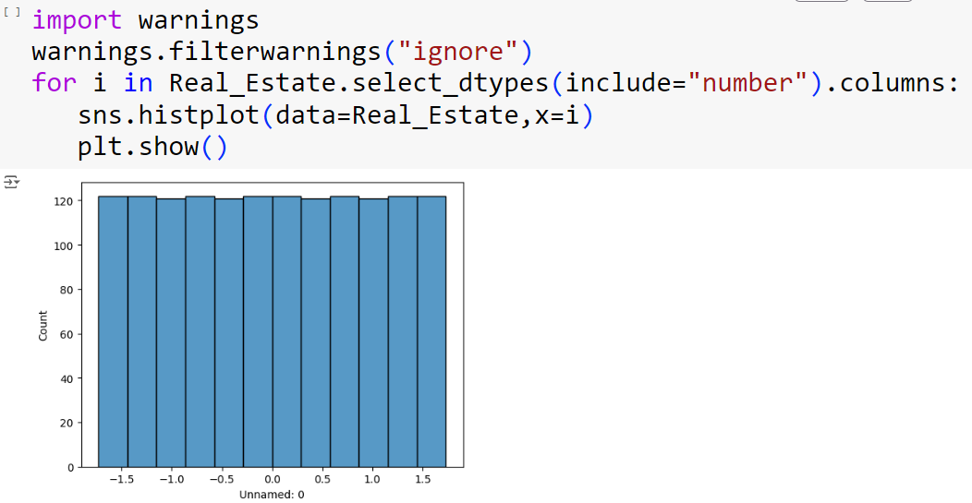
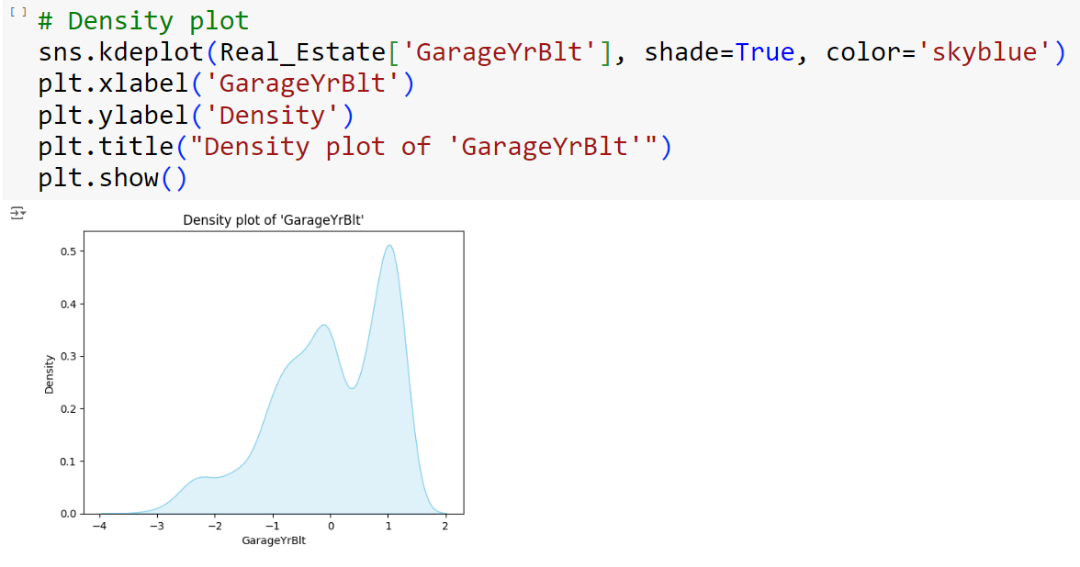
Key features

Slide 11
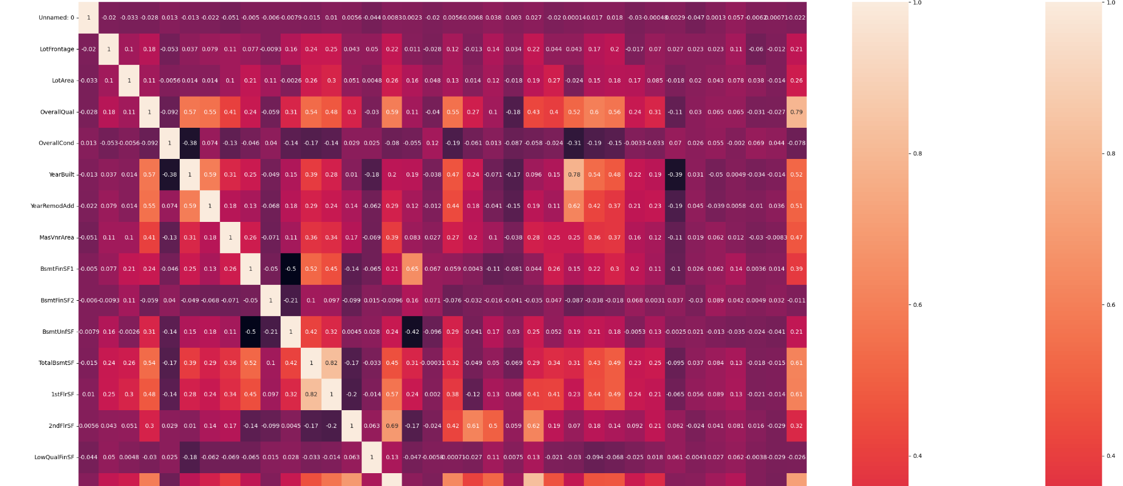
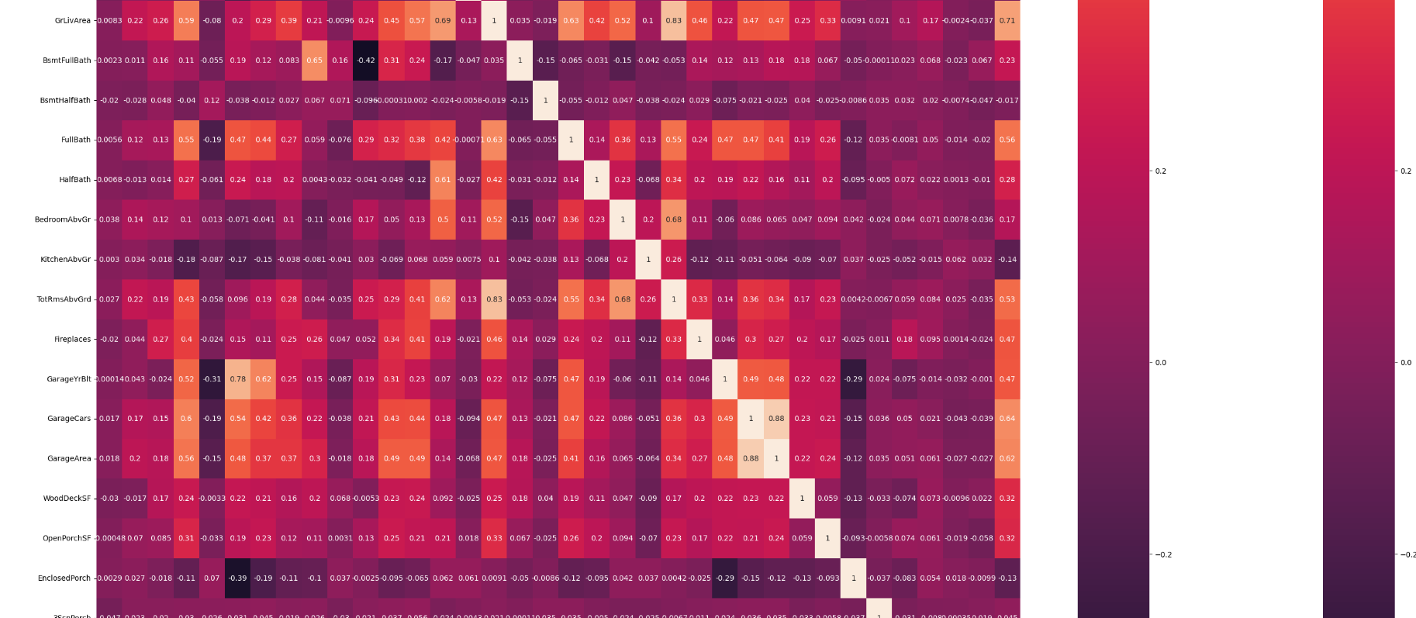
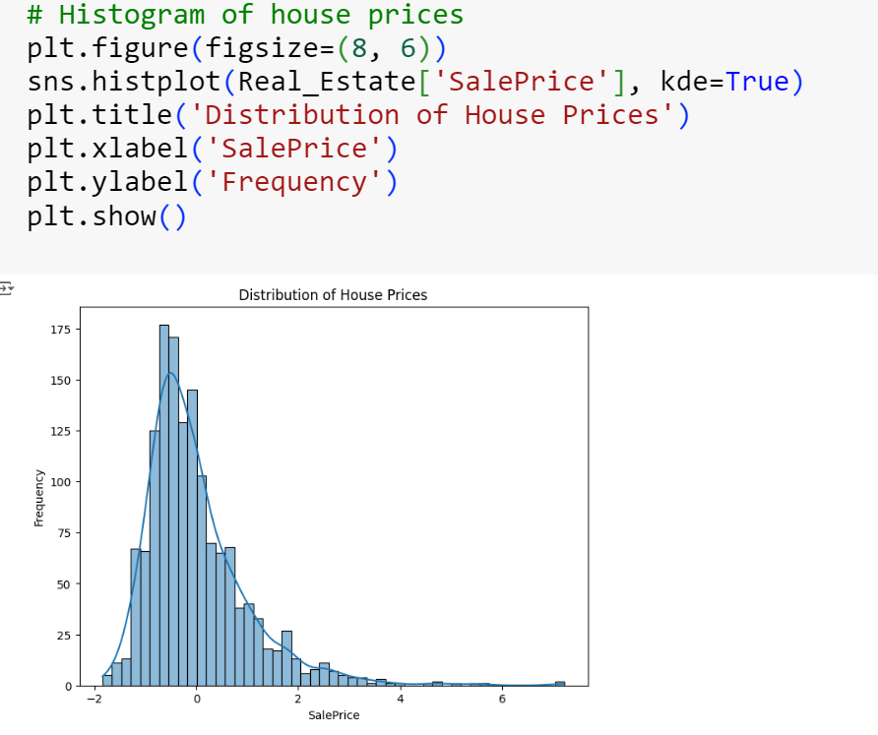
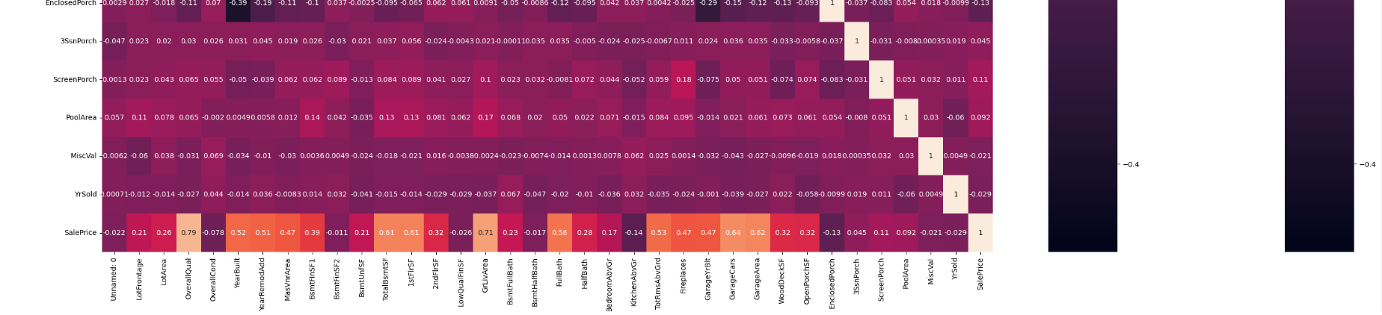
Key features
S=Real_Estate.select_dtypes(include="number").corr()
plt.figure(figsize=(35,35))
sns.heatmap(S,annot=True)
sns.heatmap(S)

Slide 12
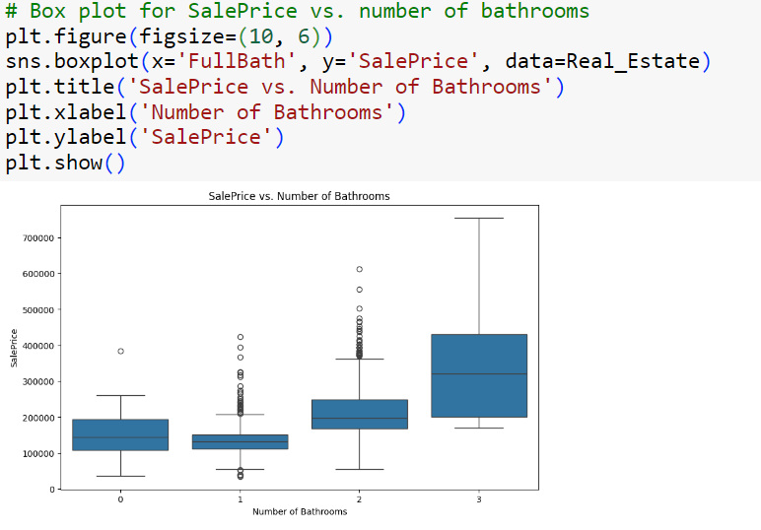
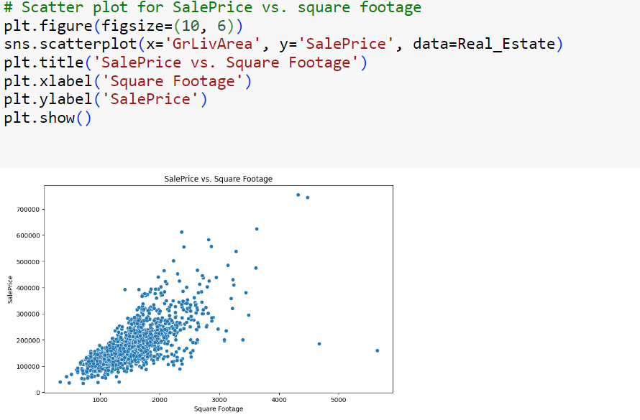
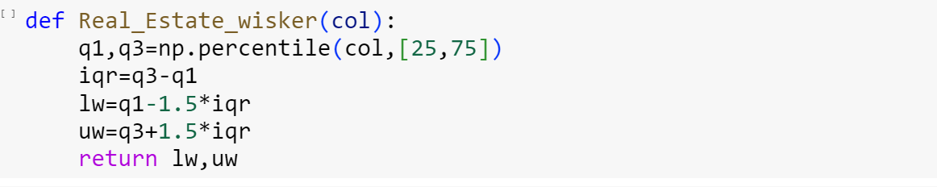
Key features

Slide 13
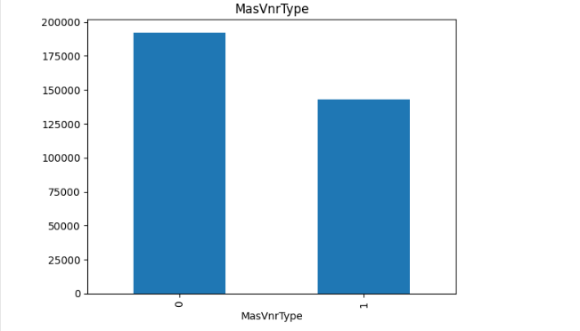
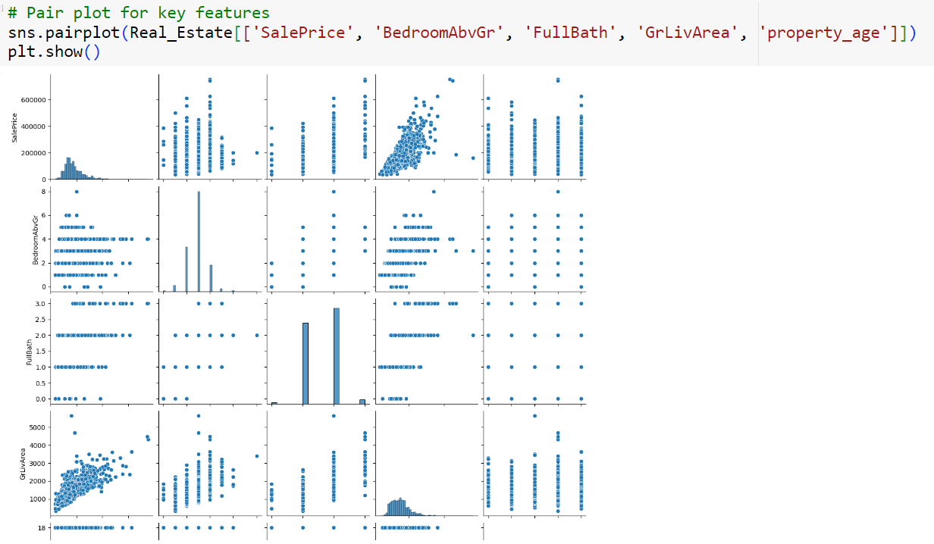
Key features

Slide 14
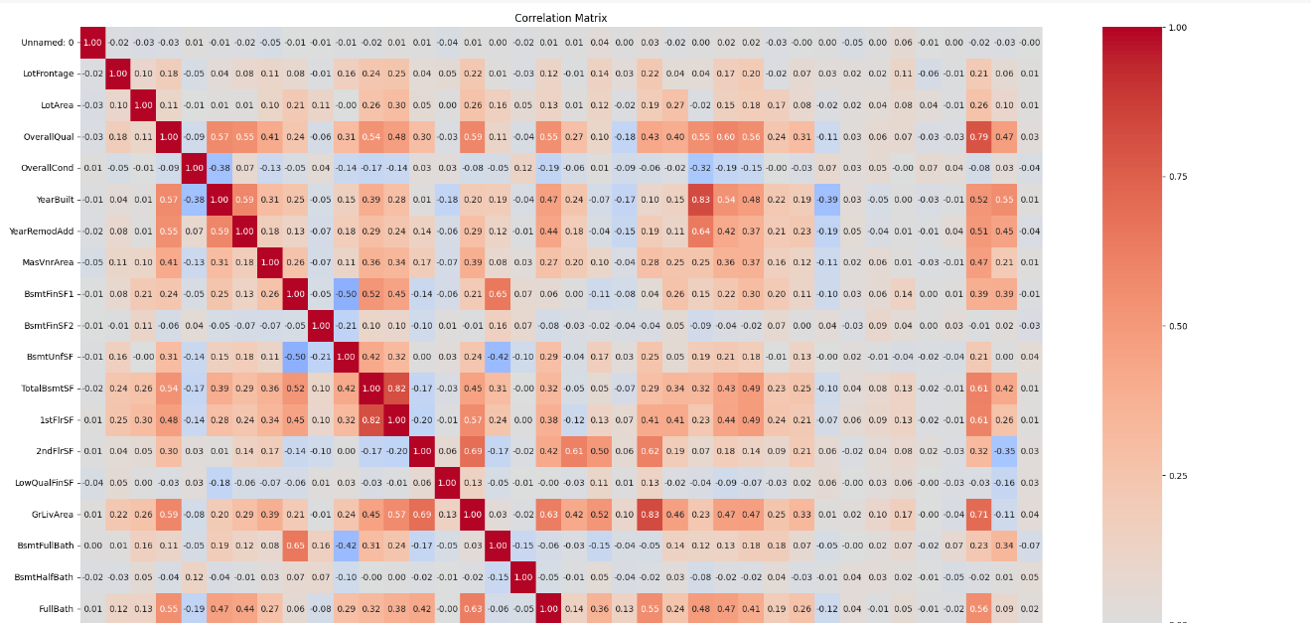
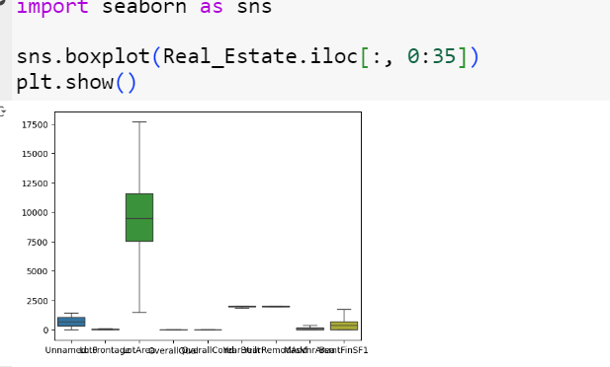
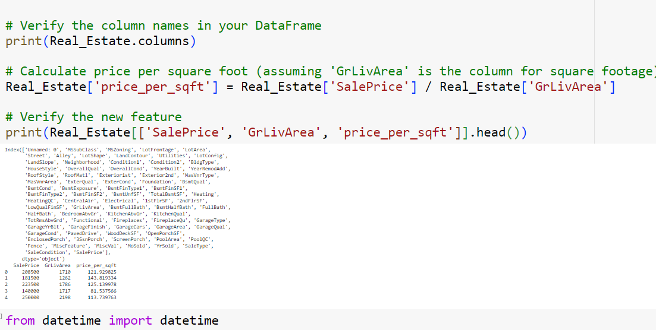
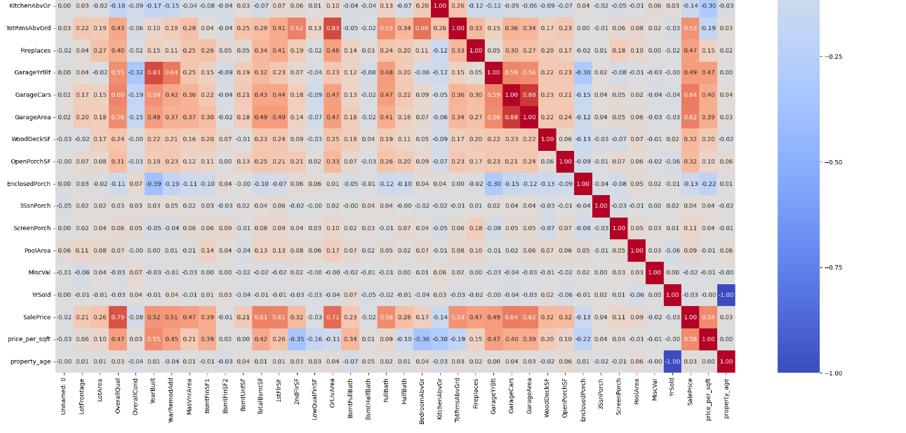
Key features

Slide 15
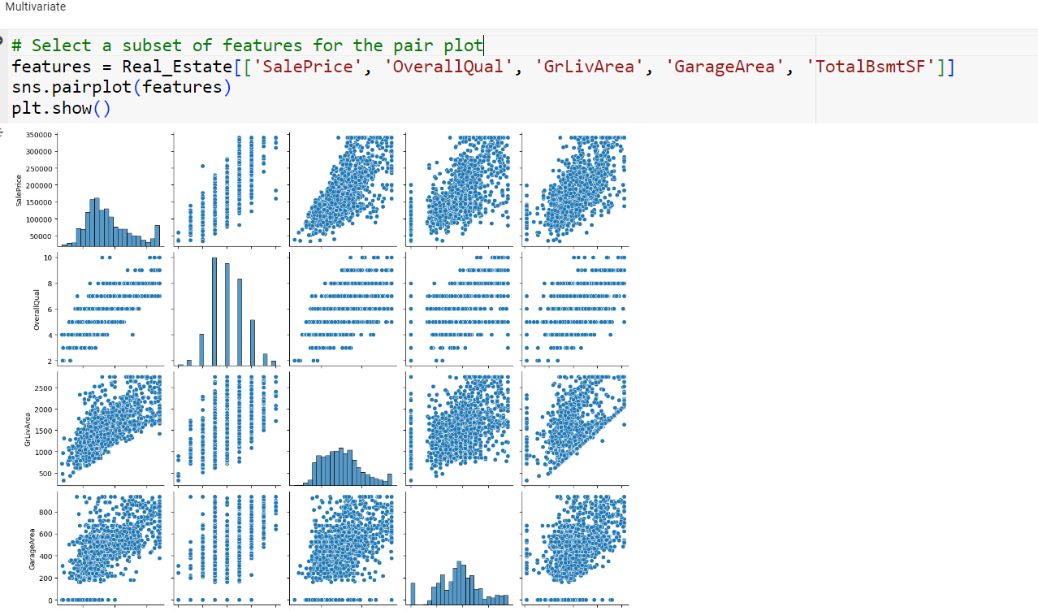
Key features

Slide 16
Key features

Slide 17
Key features
Univariate analysis of month sold

Slide 18
Result & Achievements
Identified trends in house prices over time.
Established relationships between key features and house prices.
- Incorporated economic indicators to provide a more comprehensive analysis.
Improved data quality.
Enhanced feature set.
Key insights visualized.
Model readiness.

Slide 19
Challenges faced
When i was doing this project i Faced the challenges like
1-Error occur and findings their accurate solution .
2-Sometime i occur the problem NAN value came in output.

Slide 20
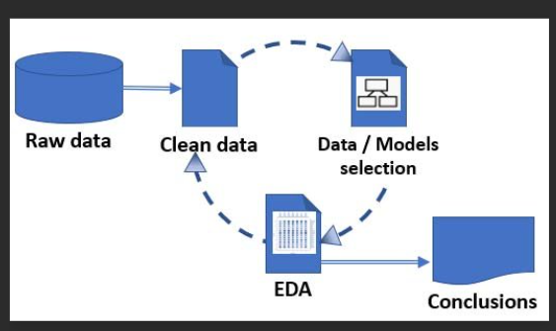
Conclusion
Conclusion
This project highlights the importance of EDA and Feature Engineering in understanding and preparing the data for modeling. By applying these techniques, we can derive meaningful insights, handle data quality issues, and develop robust predictive models. The next steps involve fine-tuning the model, validating it, and exploring advanced machine learning algorithms to improve prediction accuracy

Slide 21
Thank you

